Slide 1

Edge AI Predictive Maintenance Controller for Industry
5.0
RTOS Project Review-4
 | Under the Guidance of Dr. Srikanth Cherukuvada Assistant Professor, Department of Computer Science and Engineering, KLH CSE Bowrampet Campus
Team Members A.Sharvani – 2420090052 K.Anjali – 2420030170 M.Vinusha - 2420030212

Slide 2
Outline of Research Work
Focus
Introduction
Literature Survey
Challenges
Research Objectives
Conclusion & Future Work
References
Publications Details

Slide 3
Problem Statement
In Industry 5.0, machines continuously generate data such as temperature, vibration, and current. If abnormal changes in these values are not detected in time, they can cause machine failures, production delays, and increased maintenance costs.
The Edge AI Predictive Maintenance Controller aims to solve this problem by monitoring machine data in real time and predicting possible failures before they happen. Python and TensorFlow Lite will be used for data processing and the AI model, while MQTT will transfer sensor data between system components. RT-Linux will support real-time processing.
Docker will provide a consistent software environment, and Grafana will display machine conditions and prediction results through a dashboard.

Slide 4
Objectives
To simulate temperature, vibration, and current sensor data from industrial machines.
To monitor machine conditions in real time using RTOS concepts.
To implement task scheduling and prioritization for timely sensor-data processing.
To use AI/ML techniques to detect abnormal machine behavior and predict possible failures.
To use queues, semaphores, and mutexes for communication and synchronization between RTOS tasks.
To generate early maintenance alerts to reduce machine failures, downtime, and maintenance costs.

Slide 5
Innovation, Creativity
Combines Edge AI and RTOS to support faster and real-time machine condition monitoring.
Uses temperature, vibration, and current data together instead of depending on a single sensor.
Uses RTOS task scheduling and priorities to process sensor data within the required time.
Uses local Edge AI processing to reduce dependence on cloud-based decision-making.
Provides early maintenance alerts by detecting abnormal machine conditions before major failure.
The system is software-based and simulation-driven, making it low-cost, safe, and easy to test without physical industrial equipment.

Slide 6
Novelty of the Project
Machine-Failure Prediction
Uses a Random Forest machine-learning model to predict potential machine failure.
Multiple Machine Parameters
Uses temperature, rotational speed, torque, and tool-wear-related parameters together for machine-condition analysis.
Failure Probability
Instead of showing only a failure/non-failure result, the system provides the estimated failure probability.
Machine Health Score
Converts the prediction into an understandable machine-health indication.
Three-Level Condition Classification
The system presents machine condition as:
  NORMAL
  WARNING
  CRITICAL
Explainable AI
Feature importance helps users understand which machine parameters contribute most to the prediction.

Slide 7
Feasibility
Technical Feasibility
The project can be developed using RTOS concepts and a software simulation environment.
Temperature, vibration, and current values can be simulated as sensor data.
Python and AI/ML techniques can be used for data processing and failure prediction.
The system can be tested without physical industrial hardware.
2. Economic Feasibility
No additional cost is required for physical sensors, motors, or microcontrollers.
Open-source software and tools can be used for RTOS simulation and ML development.
The project can be developed using an existing computer, making it low-cost.

Slide 8
Oriented with Societal Needs
Industry Need
Industrial equipment failure can lead to:
Unexpected machine downtime
Production interruption
Increased maintenance costs
Equipment damage
Reduced productivity
The proposed system addresses these needs by using machine-learning-based predictive maintenance to identify possible machine failures before maintenance decisions are made.
Human-Centered Approach
The system is designed to support maintenance personnel rather than replace human decision-making.
It provides:
Failure prediction
Failure probability
Machine health score

Slide 9
Depth and Quality of Literature Review
N. Ong et al.
Title: Predictive Maintenance for Edge-Based Sensor Networks: A Deep Reinforcement Learning Approach
Methodology:
Edge-based sensor network for equipment monitoring.
Anomaly detection.
Deep reinforcement learning for maintenance policy learning.
Key Finding:
Edge AI can support predictive maintenance with faster local decision-making.
Machine-learning methods can be used to identify abnormal equipment conditions.
Limitation:
Focuses mainly on the reinforcement-learning approach.
Practical implementation on constrained real-time controllers requires further investigation.
M. K. et al.
Title: Resource-efficient Edge AI Solution for Predictive Maintenance
Methodology:
Edge AI for machine/tool-condition monitoring.
ML/DL models deployed on resource-constrained hardware.
Real-time sensor-data processing.
Key Finding:
AI models can operate close to industrial equipment.
Edge processing can reduce dependence on remote processing and support faster maintenance decisions.
Limitation:
Further research is required for broader industrial equipment and highly resource-constrained environments.

Slide 10
Depth and Quality of Literature Review
Paper 3
J. Martinez-Gil et al.
Title: An Agentic Framework for Rapid Deployment of Edge AI Solutions in Industry 5.0
Methodology:
Edge AI framework for Industry 5.0.
Local AI inference.
Modular and agent-based architecture.
Key Finding:
Edge AI supports low-latency industrial decision-making.
Modular architectures can improve flexibility and scalability.
Limitation:
Further validation is required across different industrial applications.
This paper is included in your existing Review-1 literature survey. REVIEW 1

Slide 11
Critical Analysis and Synthesis of Literature
Aspect | Literature | Proposed Project
AI-based prediction | ✓ | ✓
Edge/local processing concept | ✓ | ✓
Industrial machine parameters | ✓ | ✓
Failure classification | Some studies | ✓
Failure probability | Limited | ✓
Machine health score | Limited | ✓
Explainable feature importance | Not central | ✓
What-If Analysis | Not central | ✓
Maintenance recommendation | Limited | ✓
Human-centered decision support | Emerging | ✓

Slide 12
Synthesis
From the literature, the following observations can be synthesized:
AI/ML is useful for predictive maintenance and failure detection.
Edge processing is important when faster local decision-making is required. Monash Research
Multiple machine parameters can provide more information about machine condition than relying on a single parameter.
Interpretability remains important, particularly when AI predictions are used for maintenance decisions. Recent reviews identify insufficient XAI and realistic industrial validation as continuing challenges. DOI
Existing research includes sophisticated approaches such as deep learning, reinforcement learning, digital twins, and edge AI, but practical predictive-maintenance applications still need to balance prediction performance, interpretability, computational requirements, and usability.

Slide 13
Research Gap
Gap 1 — Limited Explainability
Many predictive-maintenance studies concentrate on prediction performance, while the reason behind an individual prediction may not always be presented clearly to maintenance users.
Our approach: Provide feature-importance information so users can understand the contribution of machine parameters.
Gap 2 — Prediction Without Decision Support
A prediction such as failure = 1 may not directly tell the maintenance user what action to take.
Our approach: Prediction → Failure Probability → Machine Health → Maintenance Recommendation
Gap 3 — Limited What-If Analysis
Conventional predictive-maintenance systems generally evaluate the current machine condition.
Our approach:
The What-If Analysis allows users to modify input parameters and examine how the predicted machine condition changes.
Gap 4 — Need for Human-Centered Interaction
Industry 5.0 emphasizes human-machine collaboration. A prediction system should therefore present AI results in an understandable form rather than only displaying raw model outputs.
Our approach: Provide NORMAL, WARNING, and CRITICAL conditions together with health information and recommendations.

Slide 14
NOVELTY OF DEVELOPED METHODOLOGY
Machine Dataset
↓
Data Preprocessing
↓
Feature Selection
↓
Random Forest Model Training
↓
Machine Failure Prediction
↓
Failure Probability Estimation
↓
Machine Health Assessment
↓
Explainable AI
↓
What-If Analysis
↓
Maintenance Recommendation
Main Input Parameters
Air Temperature
Process Temperature
Rotational Speed
Torque
Tool Wear
AI Model
Random Forest Classifier
Prediction Output
Failure / No Failure
Failure probability
Machine health score
NORMAL / WARNING / CRITICAL condition

Slide 15
ADAPTABILITY OF METHODOLOGY
Dataset Adaptability
The system can be adapted to other predictive-maintenance datasets by changing the training data and corresponding machine parameters.
Model Adaptability
Although the current implementation uses Random Forest, the methodology can be extended to other machine-learning models such as:
Decision Tree
Logistic Regression
XGBoost
Parameter Adaptability
The input parameters can be modified according to the machine and application.
For example:
Current system:
Temperature + RPM + Torque + Tool Wear

Slide 16
Possible future system:
Temperature + Vibration + Current + Pressure + RPM + Torque
Application Adaptability
The methodology can potentially be adapted for:
Manufacturing machines
Motors
Pumps
Industrial tools
Rotating equipment
Other equipment where operational data is available
Deployment Adaptability
The current system is software-based and can serve as a foundation for future deployment on edge devices with appropriate optimization.

Slide 17
METHODOLOGY EVALUATION
Dataset
The system uses the AI4I 2020 Predictive Maintenance Dataset for machine-failure prediction.
Dataset Processing
Load dataset
Select relevant machine parameters
Separate input features and target
Split data into training and testing sets
Train the Random Forest classifier
Evaluate the trained model
Integrate the model with the application
Application Evaluation
The developed application provides:
Machine condition monitoring
Failure prediction
Failure percentage
Health score
Explainable AI
What-If Analysis
Maintenance recommendation

Slide 18
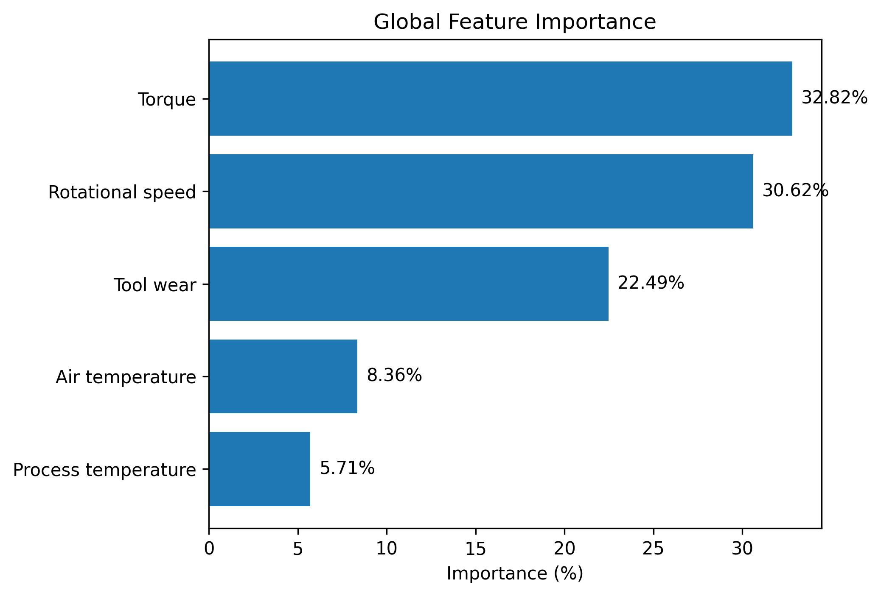
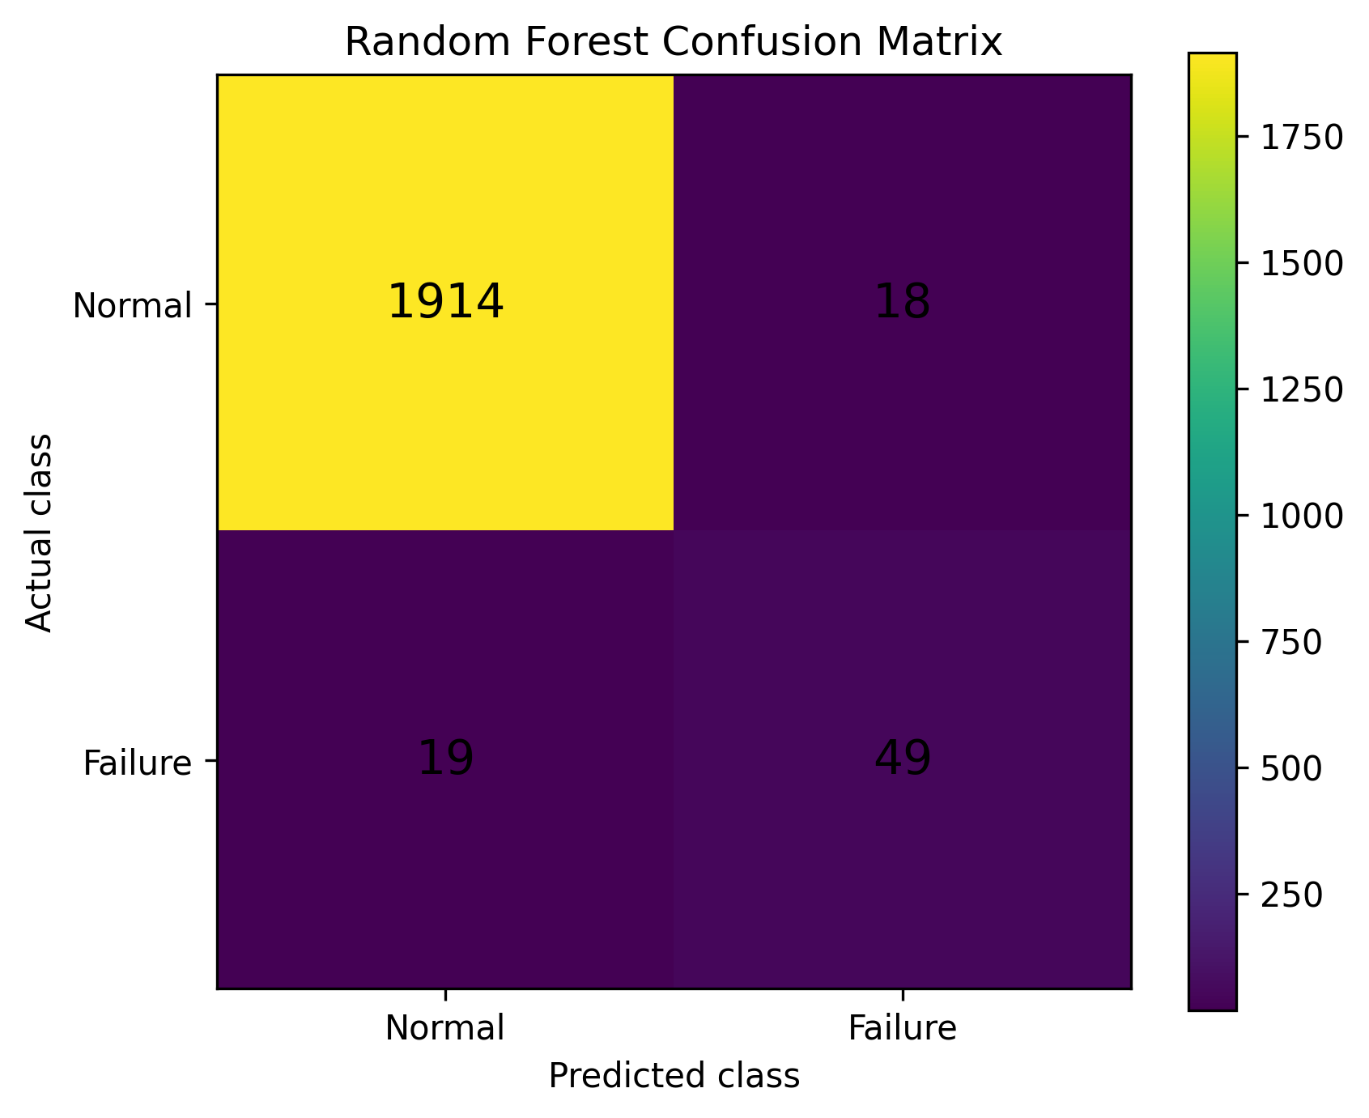
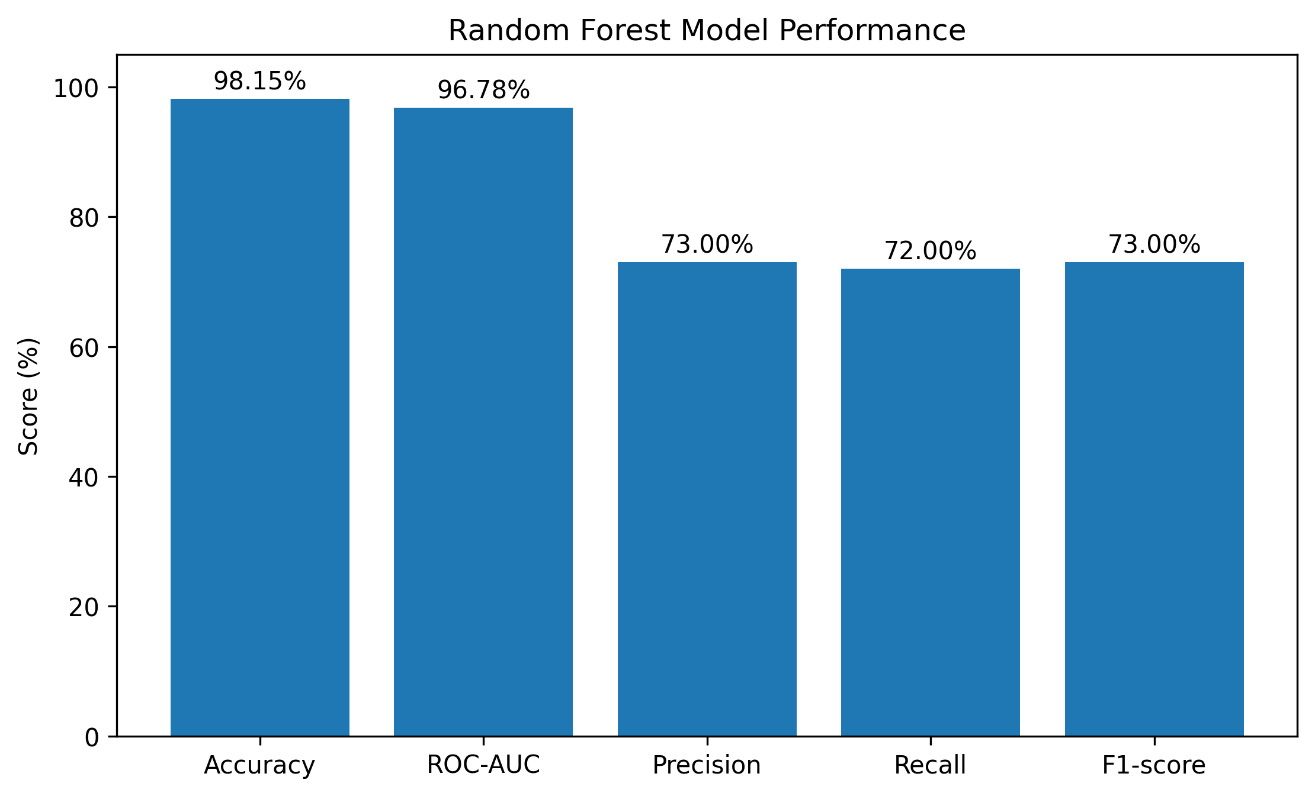

Slide 19
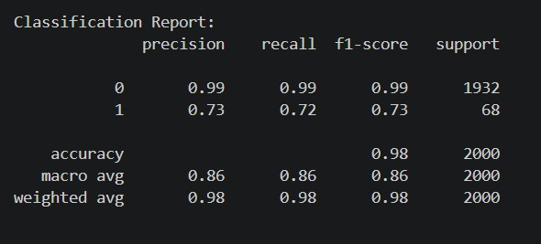
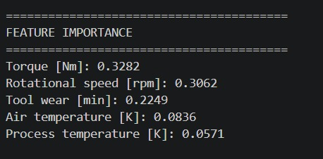

Slide 20
DISSEMINATION AND ACCESSIBILITY
ystem Accessibility
The developed system is implemented as a software-based application, making it easier to demonstrate and access without requiring physical industrial machinery.
Accessibility Features
Web-based user interface
Simple machine-parameter input
Prediction results displayed clearly
NORMAL / WARNING / CRITICAL status
Failure probability
Machine-health information
Explainable AI visualization
What-If Analysis
Maintenance recommendations

Slide 21
Dissemination
The project can be disseminated through:
Project presentation
Research paper
IEEE-style paper draft
Project documentation
GitHub repository
Demonstration of the working application
Academic review presentations
Reproducibility
The methodology can be reproduced using:
Dataset
Python environment
Machine-learning libraries
Trained model
Backend API
Frontend application

Slide 22
Accuracy of Results
Dataset: AI4I 2020 Predictive Maintenance Dataset
Model: Random Forest Classifier
Training samples: 8,000
Testing samples: 2,000
Performance
Accuracy: 98.15%
ROC-AUC: 96.78%
Failure Precision: 73%
Failure Recall: 72%
Failure F1-score: 73%
Confusion Matrix
Keep your Random Forest Confusion Matrix image on this slide.
Confusion Matrix:
Normal correctly predicted: 1914
Normal incorrectly predicted as Failure: 18
Failure incorrectly predicted as Normal: 19
Failure correctly predicted: 49

Slide 23
Feature Importance and Result Analysis
Feature | Importance
Torque | 32.82%
Rotational Speed | 30.62%
Tool Wear | 22.49%
Air Temperature | 8.36%
Process Temperature | 5.71%
Result Interpretation
Torque, rotational speed, and tool wear were the three most influential features in the trained Random Forest model.

Slide 24
Technical Competence
Technologies Used
Python — data processing and model development
Pandas / NumPy — data handling
Scikit-learn — Random Forest model
FastAPI — prediction backend
React/Vite — user interface
Joblib — trained-model storage
Technical Features
Machine-failure prediction
Failure probability
Health score
Explainable AI
What-If Analysis
Maintenance recommendation

Slide 25
Innovative and Sustainable Features
Innovative Features
Sustainable Features
Integrated machine-failure prediction
Failure probability estimation
Machine health score
NORMAL / WARNING / CRITICAL classification
Explainable AI using feature importance
What-If Analysis
Maintenance recommendations
Human-in-the-loop decision support
Software-based implementation
No physical industrial machine required for development
Low-cost development using software tools
Reusable methodology
Can be adapted to other machine datasets
Can be extended toward real industrial edge deployment

Slide 26
Utility to Society
The proposed system can support industrial maintenance by providing:
Early identification of potential machine failure
Machine-condition assessment
Maintenance planning support
Data-driven decision support
Reduced dependence on purely reactive maintenance
Explainable AI information for maintenance personnel
Human-centered Industry 5.0 interaction
AI Prediction
↓
Failure Probability
↓
Machine Health
↓
Explanation
↓
Maintenance Recommendation
↓
Human Decision

